Slide 1

Unit 1: Introduction to Treble Clef
Start

Slide 2

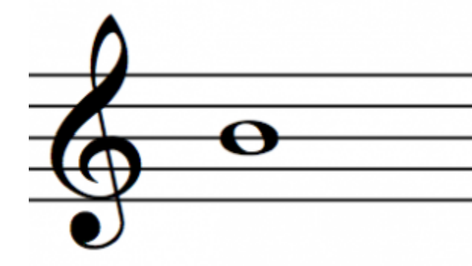
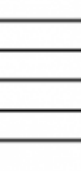


Submit
C
C#
Db
D#
Eb
F#
Gb
G#
Ab
A#
Bb
D
E
F
G
A
B

Slide 3
Display Letter Names:
MIDI
Keyboard
App Keyboard
Submit
Quit Lesson
C
C#
Db
D#
Eb
F#
Gb
G#
Ab
A#
Bb
D
E
F
G
A
B

Slide 4
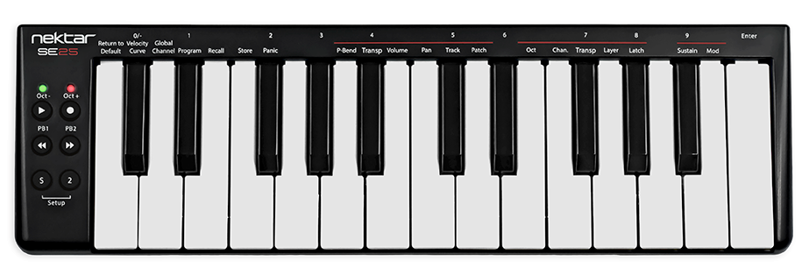


Display Letter Names:
MIDI
Keyboard
App Keyboard
Submit
Quit Lesson
C
C#
Db
D#
Eb
F#
Gb
G#
Ab
A#
Bb
D
E
F
G
A
B

Slide 5
Display Letter Names:
MIDI
Keyboard
App Keyboard
Submit
Quit Lesson
C
C#
Db
D#
Eb
F#
Gb
G#
Ab
A#
Bb
D
E
F
G
A
B

Slide 6



Display Letter Names:
MIDI
Keyboard
App Keyboard
Submit
Quit Lesson

Slide 9
Lesson Complete
Back to Menu
Next Lesson

